Slide 1
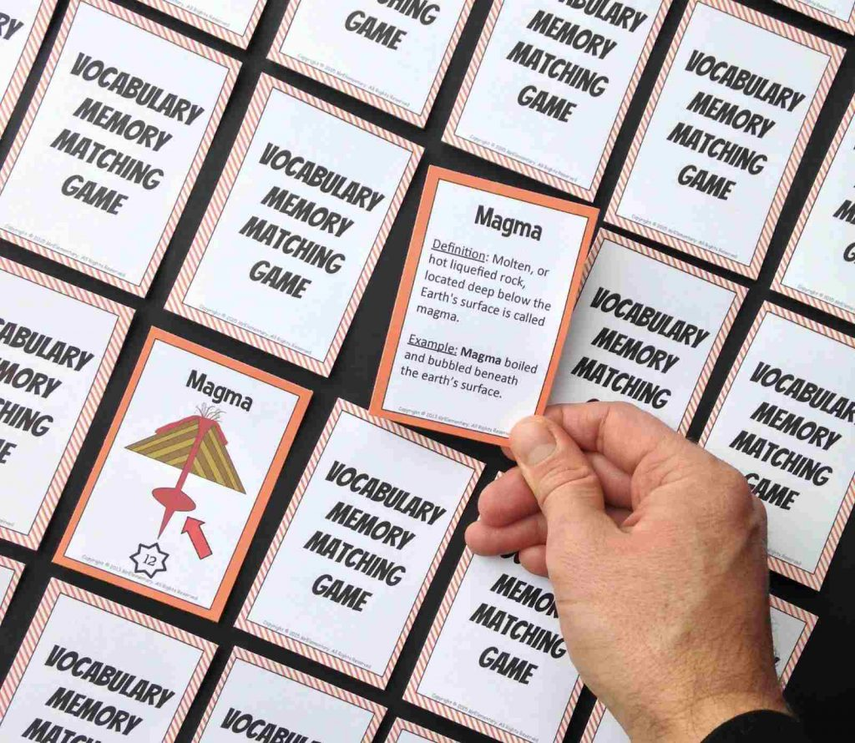
Word Explorer
Explore new vocabulary terms with mini games to level up your communication skills!
Created by: Laeyla Nelson

